Slide 1
Consumer Analysis & Forecasting for
John Newcombe Country Club

Slide 2
INTRODUCTION
General Notes
Data was generated exclusively from Club Automation POS system. Because JNCC uses other POS system, the insights should not be assumed to mirror JNCC's revenue. However because the size of data is relatively large, the trends and patterns likely reflect actual movements.
Product category Program was excluded because payments are moved to RegFox, which is another POS system. Program category includes historical sales from the following:
Swim Lessons
Camp
Swim Camp
Kid Fit
Teen Performance Camp
The product categories and items included in the data are deliberately chosen to help forecast items that are currently offered by JNCC. An example of items removed from the analysis is Soccer Club sales, which was previously in the Club Automation POS but had been moved to another POS system, separate from JNCC. The list of item groups per product category are shown on the side.
Product Categories and Item Groups
Admin | Bar | Tennis | Fitness | Pro Shop | Events
Guest Fee | Beverage | Adult Clinics | Personal Training | String | Special Event
Membership Dues | Food & Consumables | Tennis Lessons | Fitness Lessons | Accessories | Date Night
Food Allowance | Wine | Leagues |  | Racquet Rental | Dinners
Membership Initiation | Beer | Junior Clinics |  | Apparel | Fitness Special Event
Homeowner Membership Initiation |  |  |  | Tennis Balls | Social Event
Facility Rental |  |  |  | Shoes | 24 Hour of Tennis
Court Time |  |  |  | Restring/ Labor Only
Sponsorship |  |  |  | Racquets

Slide 3
SUMMARY OF FINDINGS & RECOMMENDATIONS
1 of 3
Revenue does not reflect the entire story of growth or decline. Consider measuring additional KPIs than revenue that aligns more to CDT’s vision like Engagement and Net Promoter Score.
Bar engagement is high but revenue is low because of the relative price of items sold. In this product category, quantity (engagement) drives revenue. In the same thread, Pro Shop revenue stales despite promising engagement because of the variance of price in the items sold. For instance, Racquets which is the second highest driver of Pro Shop revenue at 20% only accounts for 5% of touchpoint in this category.
Tennis revenue is trending up, but engagement moves oppositely.
These findings imply that revenue cannot be the sole metric for business health.
To find which KPIs impact the business, go back to the vision of the club or CDT. Engagement can be a measure of growing the game of tennis; while Net Promoter Score can measure the perceived value of members/guests and can guide leadership if “CDT experience” is actually being felt by customers.

Slide 4
SUMMARY OF FINDINGS & RECOMMENDATIONS
2 of 3
JNCC and tennis business in general is highly seasonal. Strategize product cross-selling, court usage, promos, etc. to create an omnipresent business.
Del Monte had the seasonality curse with their canned pineapples. In their market research, they discovered that Filipinos used canned pineapples primarily for fruit salad which is a traditional celebratory dessert. This purchase behavior explains why canned pineapple sales would spike in December and plateau most of the year as Filipino families serve fruit salad only on Christmas, and sometimes on birthdays. To solve the seasonality problem, Del Monte introduced recipes that included pineapples like “Chicken and Pineapple” and “Sweet and Sour Fish Fillet” and marketed these dishes through their multimedia products, Del Monte Kitchenomics Recipe Book and TV Show. In the next 5-10 years, Del Monte saw higher canned pineapple consumption.
How can tennis be an everyday idea to customers?

Slide 5
SUMMARY OF FINDINGS & RECOMMENDATIONS
3 of 3
Think outside demographic-based rec center mindset. Country club membership is less of a fitness venue and more of a lifestyle where loyalty exists.
Del Monte had the seasonality curse with their canned pineapples. In their market research, they discovered that Filipinos used canned pineapples primarily for fruit salad which is a traditional celebratory dessert. This purchase behavior explains why canned pineapple sales would spike in December and plateau most of the year as Filipino families serve fruit salad only on Christmas, and sometimes on birthdays. To solve the seasonality problem, Del Monte introduced recipes that included pineapples like “Chicken and Pineapple” and “Sweet and Sour Fish Fillet” and marketed these dishes through their multimedia products, Del Monte Kitchenomics Recipe Book and TV Show. In the next 5-10 years, Del Monte saw higher canned pineapple consumption.
How can tennis be an everyday idea to customers?

Slide 6
RECOMMENDATIONS
Grow from demographic-based gym-membership type
Use loyalty to see how you engage, treat, and provide value to customers or make a loyalty/rewards based system, and/or
Evaluate add-on packages to create higher value perception.
Tennis add-on, Fitness add-on, Combined add-on and strategically include offerings (court optimization, etc.)

Slide 7
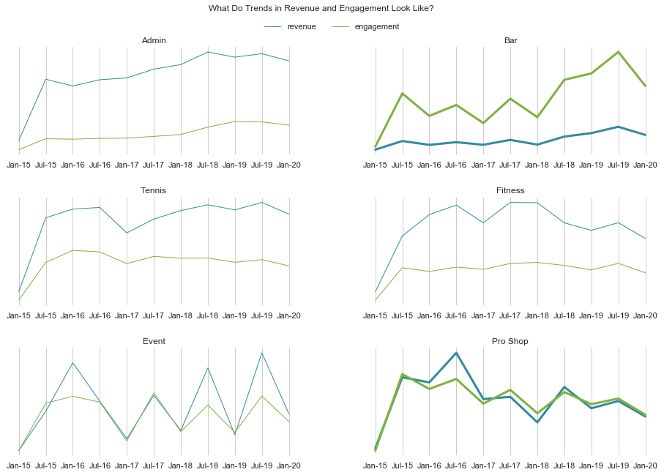
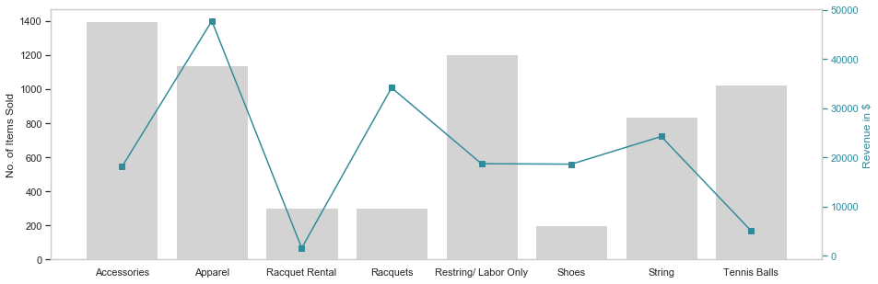
TREND & SEASONALITY
Revenue and Engagement in Bar are oppositely proportionate, and in Pro Shop, disproportionate.
Scaled Representation of Revenue and Engagement
■ Revenue ■ Engagement
BAR. While the engagement touchpoints are high (customers buy frequently), the items are priced relatively lower.
PRO SHOP. The engagement touchpoints are not generating desired revenue. This pattern usually happens when revenue is highly affected by an abnormally-high or abnormally low-priced item. In this case, Racquets are the second highest revenue-generating item while being the second least bought item as seen in the graph below.
Note: the graph shows revenue and engagement on the same scale. If the engagement and revenue are proportionate to each other, engagement line sits just below revenue line and roughly follows the same movement.

Slide 8
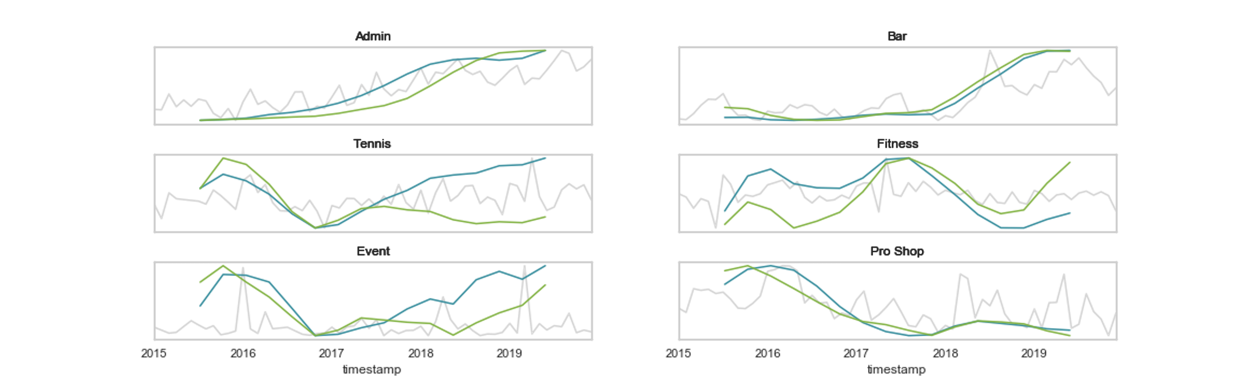
TREND & SEASONALITY
Tennis revenue is uptrending, while engagement is downtrending.
Tennis engagement fell in 2017 through 2018, but has picked up in 2019. Revenue rise does not reflect engagement increase.
Year | Revenue % change | Engagement % change
2015 | baseline | baseline
2016 | +0.48% | +5.64%
2017 | -0.68% | -2.50%
2018 | +8.99% | -6.77%
2019 | +9.42% | +4.22%
Year Over Year Trend in Revenue and Engagement of Product Categories
■ Actual Revenue ■ Revenue ■ Engagement

Slide 9
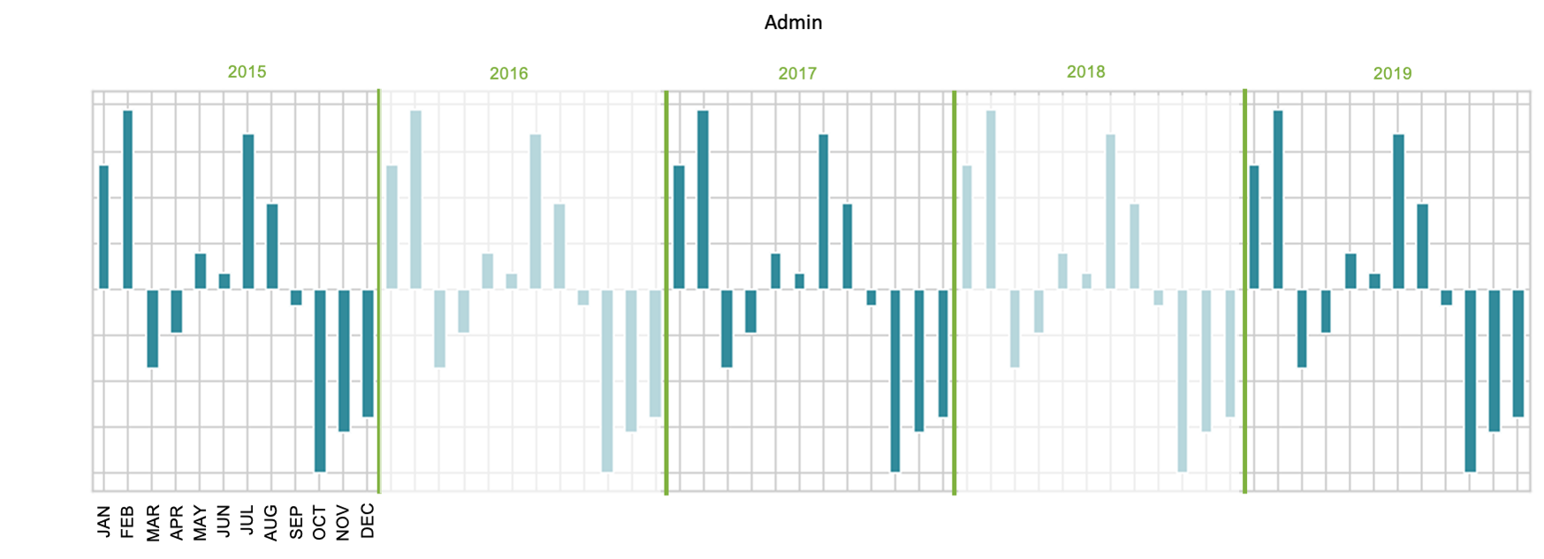
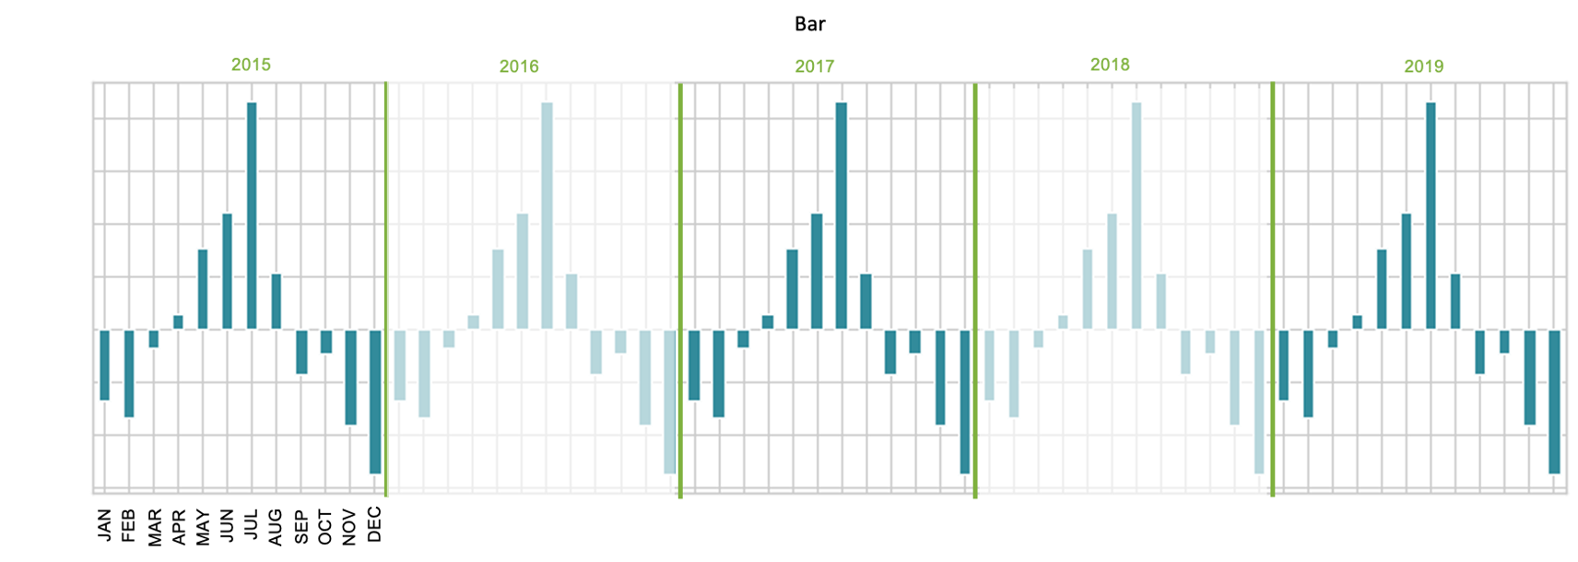
TREND & SEASONALITY
1
The following graphs (1-6) show the decomposed monthly seasonality for each category. Decomposed seasonality is revealed when trend and residual patterns are stripped from actual observations.
2
ADMIN. Admin peaks in the first two month of the year and declines in the last three months.
BAR. Bar revenue follows tri-season (Spring-Summer-Fall/Winter) pattern with Summer being the peak.

Slide 10
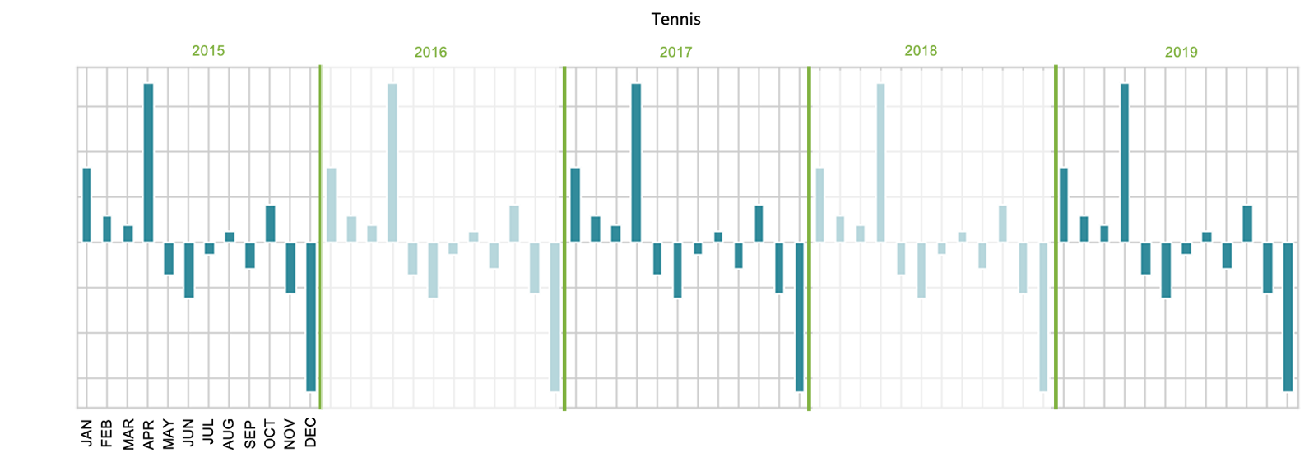
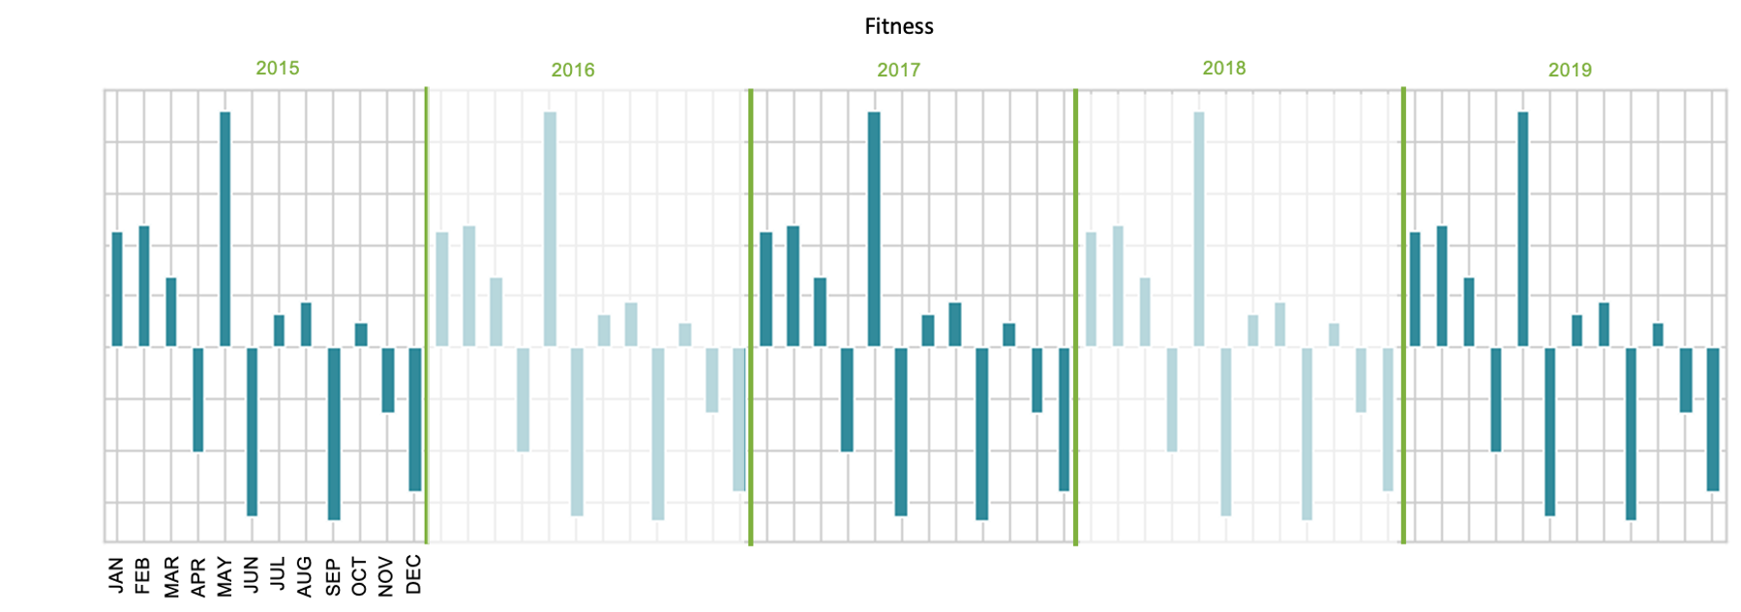
TREND & SEASONALITY
3
The following graphs (1-6) show the decomposed monthly seasonality for each category. Decomposed seasonality is revealed when trend and residual patterns are stripped from actual observations.
4
TENNIS. April is the peak of tennis revenue, while December shows steep decrease.
FITNESS. Fitness revenue have steady showing in the first three months of the year and peaks in May. Troughs don’t show momentum, and sporadically happen in April, June, September, and December.

Slide 11
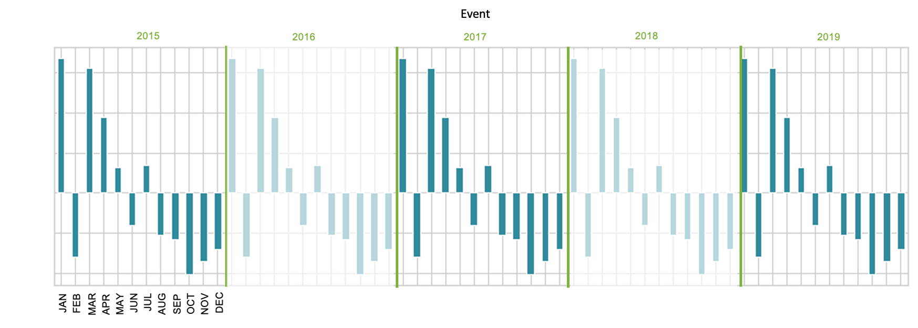
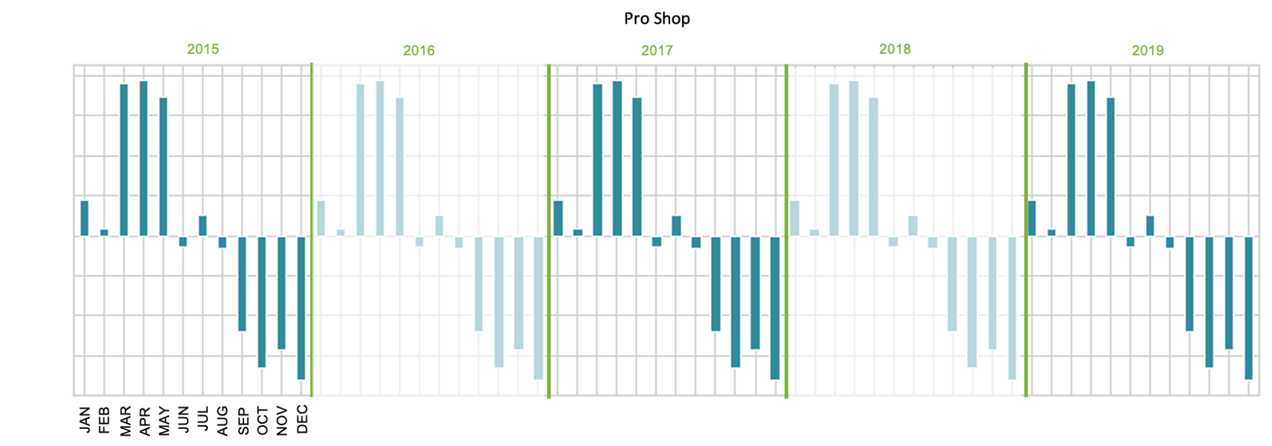
TREND & SEASONALITY
5
The following graphs (1-6) show the decomposed monthly seasonality for each category. Decomposed seasonality is revealed when trend and residual patterns are stripped from actual observations.
6
EVENT. Event revenue peaks in January and March but slows down in the last five months of the year.
PRO SHOP. The height of pro shop revenue is in the Spring months (Mar-Jun) and dips in the Fall/Winter months (Sep-Dec).

Slide 12
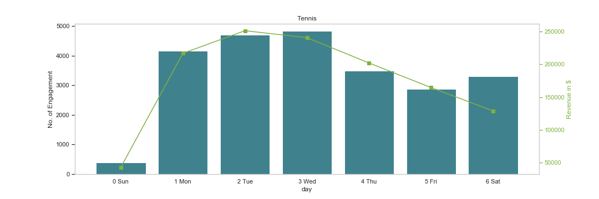
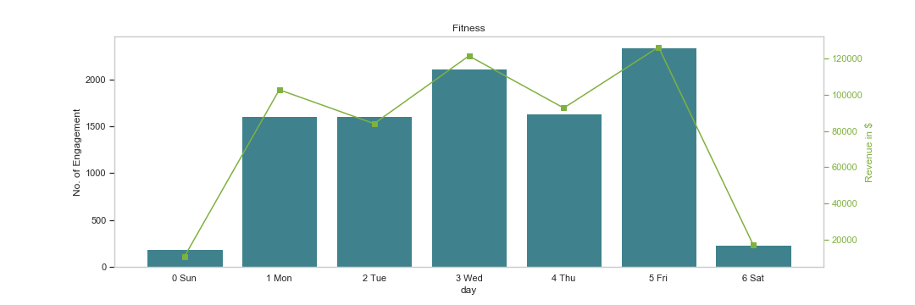
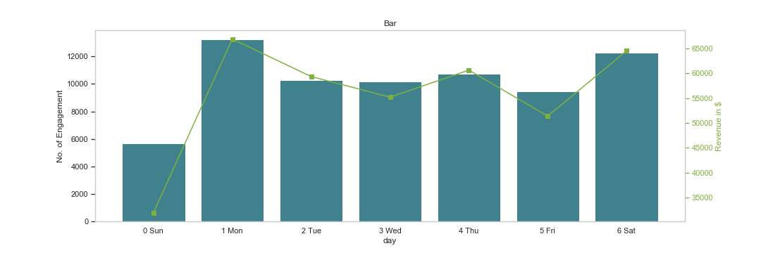
TREND & SEASONALITY
Among the six categories, Tennis, Fitness, and Bar displayed weekly seasonality in terms of engagement.
TENNIS. Thursday and Friday shows less engagement. Optimize court usage on these days.
FITNESS. Mondays, Tuesdays and Thursdays show lower engagements. These are the most optimal days to execute promotions to support engagement and revenue.
BAR. Bar engagement and revenue peaks on Monday and Saturday. Since bar is a low-revenue generating category, promotions should be used in highly engaged days to increase engagement and presuppose value perception.

Slide 13
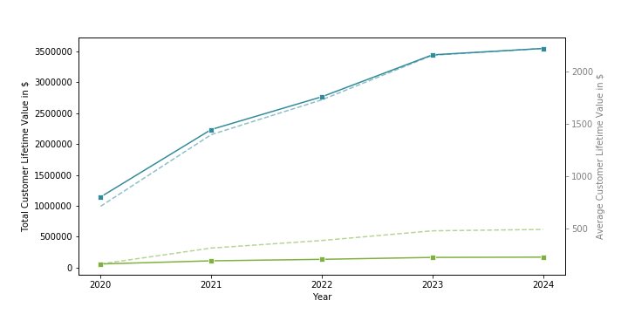
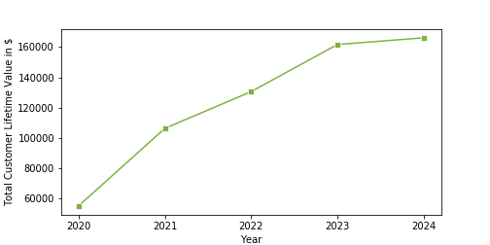
CUSTOMER LIFETIME VALUE & LOYALTY
■ Member ■ Guest
Customer Lifetime Value (CLV) is increasing in the next five years.
JNCC will gain more dollar value out of its members in the next five years if the current business trend is maintained, if not grown.
The average CLV per member and guest is also seen to increase over the next five years.
While the total CLV gained from guests are significantly lower than that of members’, the average CLV for guest is also projected to increase so their presence can also sustain increasing business growth.
Zooming in on total guest CLV in $
Note: CLV and Loyalty are both derived from the RFMT model. CLV gives an actual dollar value, while Loyalty classifies members to groups.

Slide 14
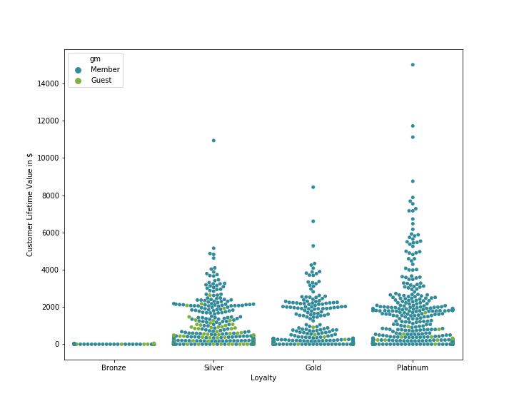
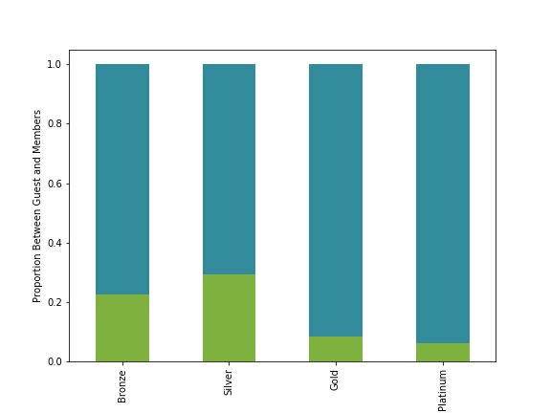
CUSTOMER LIFETIME VALUE & LOYALTY
As expected, members are more loyal than guests. Note the guests with high level of loyalty and convert them to members.
Distribution of Members and Guests within Loyalty Groups and their Customer Lifetime Value
■ Member ■ Guest
There are less guests in Gold and Platinum groups. But notice that a bigger proportion of Silver members have higher CLV compared to Gold. This indicates that the clustering model has apportioned less weight to monetary value than the other features in the RFMT model (i.e., recency, frequency, tenure).

Slide 15
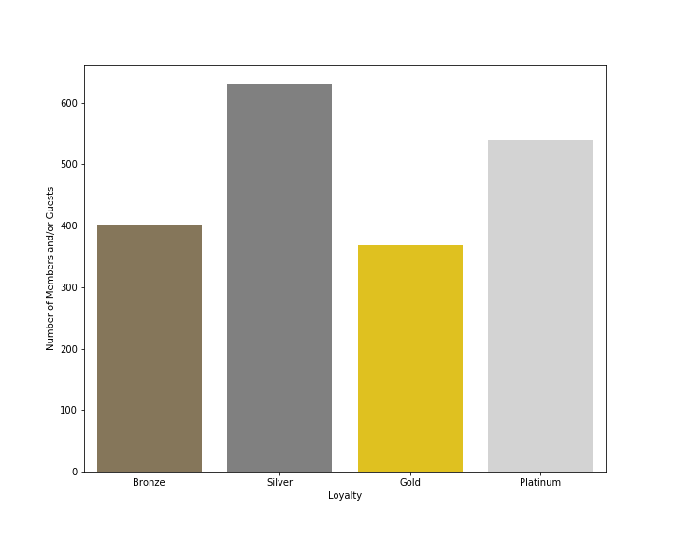
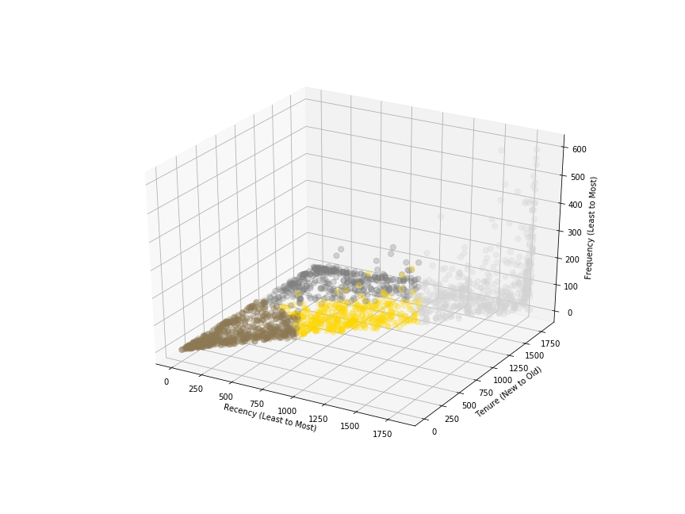
CUSTOMER LIFETIME VALUE & LOYALTY
Loyalty groups are distinctly clustered by the model primarily by Recency, Frequency, and Tenure. Although Monetary Value is also considered in classifying “Loyalty” among members and guests, the model has apportioned lower weight to this feature
Distribution of Loyalty between Members and Guests
Characteristic of members and guests in each loyalty group:
BRONZE. Newer group in terms of tenure and have not recently used/purchased the clubs’ product/services.
SILVER. Members/guests who have engaged with JNCC longer than Bronze but purchased/used the clubs’ product/services recently.
GOLD. Used/purchased the clubs’ product/services more recently than Silver and do so more frequently.
PLATINUM. Long-time patrons of JNCC and use/purchase products and services more frequently and recently.
Customers and their Corresponding R,F,T Values

Slide 16
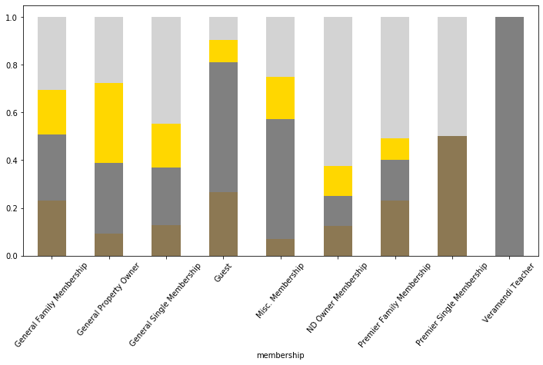
CUSTOMER LIFETIME VALUE & LOYALTY
The current membership tiers/offerings do not reflect loyalty (RFMT-based model). The varied purchase behavior of members and guests across membership types might explain the disconnect between perceived value in membership.
With the exception of ND Owners who are primarily Platinum members, Premier Single who are either Bronze or Platinum (this wide gap raises a concern), and Veramendi Teacher group who primarily portrays a Silver behavior, each member type use/engage in club’s products and services differently.
■ Bronze
■ Silver
■ Gold
■ Platinum

Slide 17
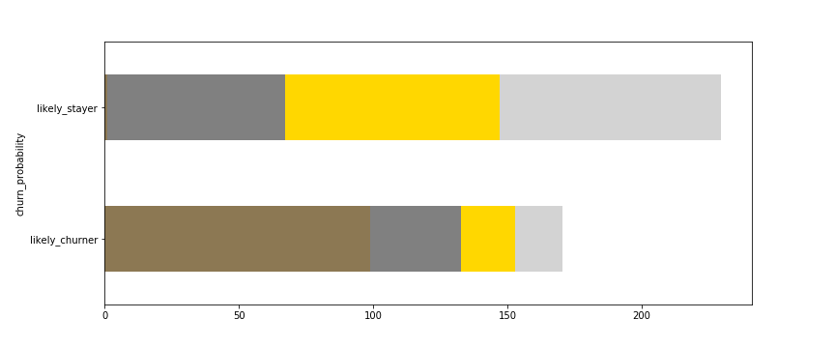
PROBABILITY OF CHURN
While relatively small, there is a probability of churn among Gold and Platinum group. Ideally, probability of churn should be seen in Bronze and Silver groups only.
Probability of churn is derived from the predicted number of purchases in the next 2 years. Members/guests with a predicted number of purchase of less than 1 in this predicted period are labeled as likely churner.
Look at the members/guests who are Gold and Platinum and are labeled as likely churner and make active steps towards keeping them alive as customers.
■ Bronze
■ Silver
■ Gold
■ Platinum

Slide 18
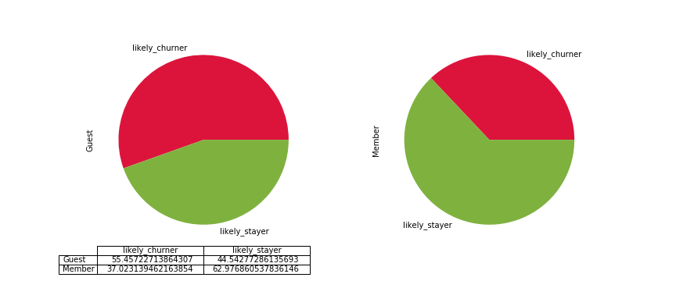
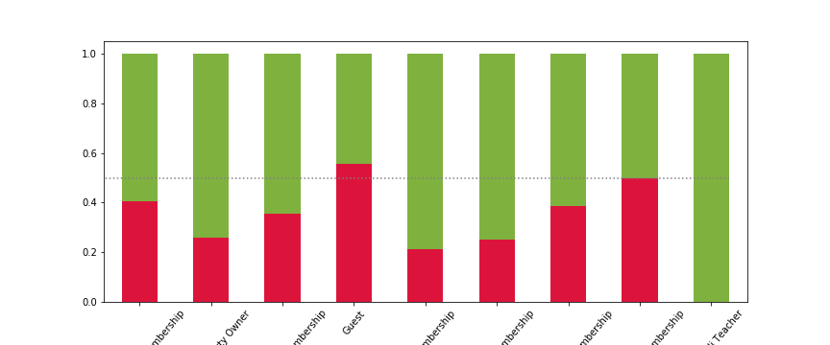
PROBABILITY OF CHURN
Probability of churn among member types. Most membership types have less than 40% probability of churning.
Members are 62% more likely to stay.
62%
Guests are 56% more likely to churn.
56%

Slide 19
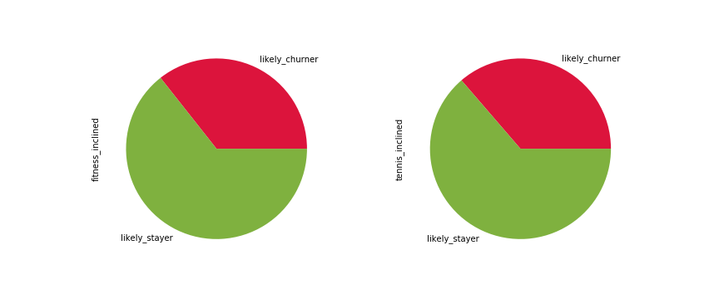
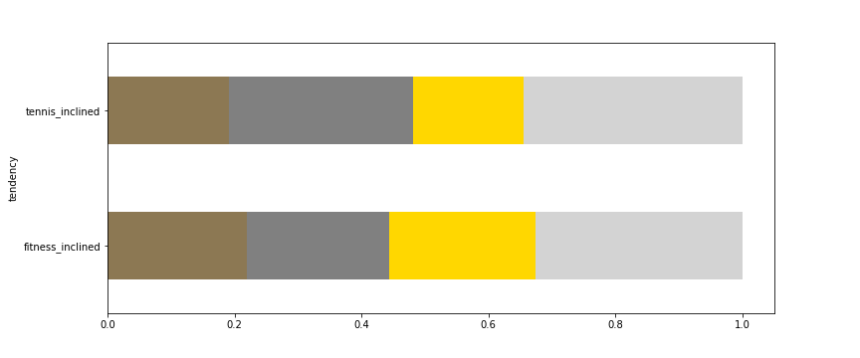
TENNIS AND FITNESS INCLINATION
Tennis- and Fitness- inclined members roughly look the same in terms of purchase/engagement behavior.
There are more Gold members/guests in the Fitness-inclined group, so loyalty are quite higher than those of Tennis-inclined. However, there are less Bronze members in the Tennis—inclined group.
Churn Probability of Tennis- and Fitness-Inclined Members and Guests
Percentage Distribution of Loyalty between Tennis- and Fitness-Inclined
Tennis-inclined
Fitness-inclined
■ Bronze. ■ Silver. ■ Gold. ■ Platinum

Slide 20
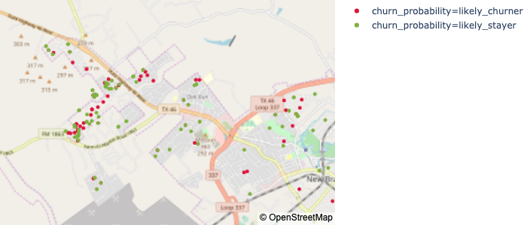
GEOMAPPING

Slide 21
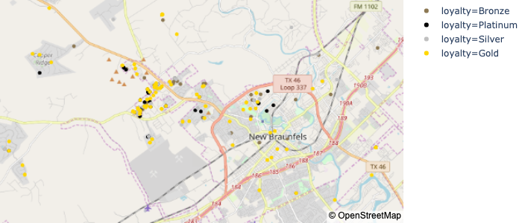
GEOMAPPING

Slide 22
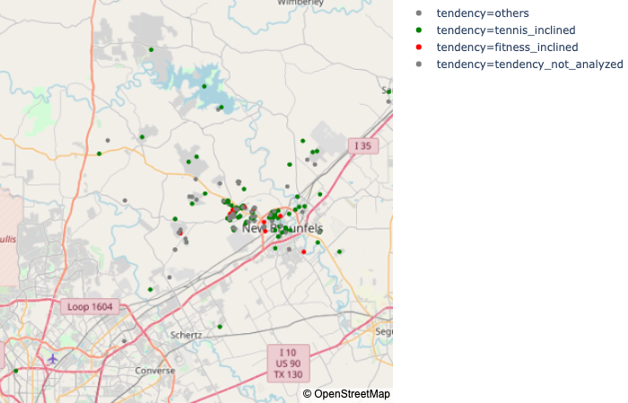
GEOMAPPING

